Slide 1
Nagayya Nandan Revuri
Networking: *Computer networking refers to interconnected computing devices that can exchange data and share resources with each other. These networked devices use a system of rules, called communications protocols, to transmit information over physical or wireless technologies.
4 Types of Networks:
* LAN (Local Area Network)
* PAN (Personal Area Network)
*MAN (Metropolitan Area Network)
*WAN (Wide Area Network)

Slide 2
Two main Types of Network :
* LAN
* WAN
Features of Computer Network :
* Scalability: Scalability refers to the ability to add new network components
*Software and Hardware Sharing/Compatibility
*Data and File Sharing
*Performance
*Backup
*Security
*Reliability
*Communication Speed

Slide 3
IP Address ( Internet Protocol ) :
* A number used to identify a computer or network of computers
Types of IP Addresses :
Public
Private
Static
Dynamic
Classes of IP Addresses :
* There are five classes of available IP ranges:
*Class A, Class B, Class C, Class D and Class E,
*while only A, B, and C are commonly used. Each class allows for a range of valid IP addresses

Slide 4
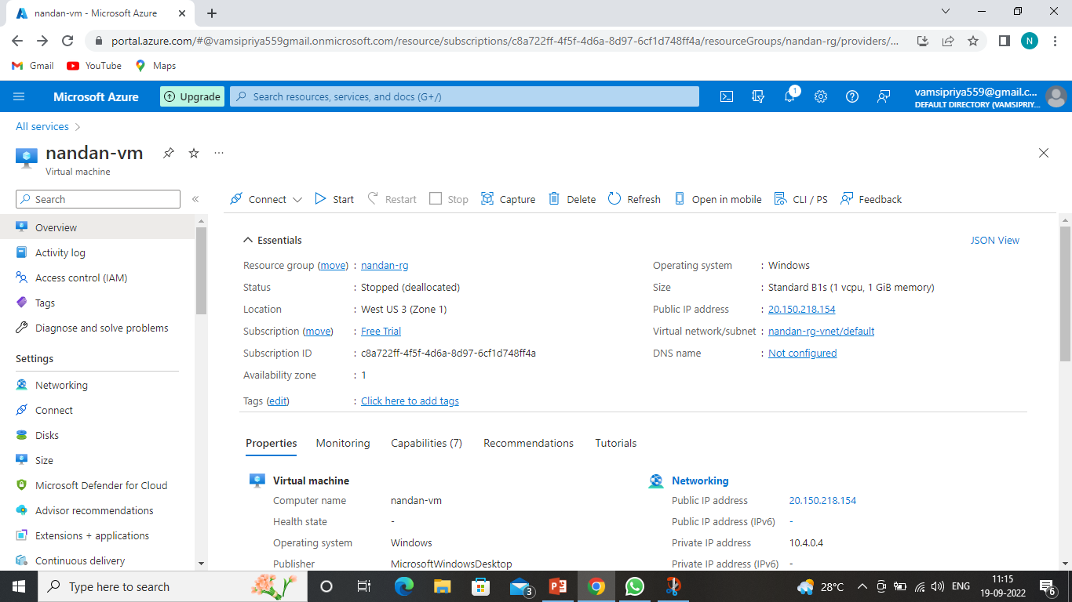

Slide 5
Thank you

